Slide 1
CS3391 Object Oriented Programming
Dr.D.Sivaganesan, Professor, PSGiTech / CSE
1

Slide 2
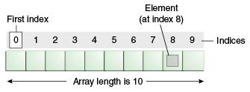
ARRAYS
Array is a collection of similar type of elements that have contiguous memory location.
In Java all arrays are dynamically allocated.
Since arrays are objects in Java, we can find their length using member length.
A Java array variable can also be declared like other variables with [] after the data type.
The variables in the array are ordered and each have an index beginning from 0.
Java array can be also be used as a static field, a local variable or a method parameter.
The size of an array must be specified by an int value and not long or short.
The direct superclass of an array type is Object.

Slide 3
Types of Array in java
One- Dimensional Array
Multidimensional Array
Syntax:
type var-name[ ];
Instantiation of an Array in java
array-var = new type [size];
int a[]=new int[5];//declaration and instantiation
a[0]=10;//initialization

Slide 4
class Testarray{
public static void main(String args[]){
int a[]=new int[5];//declaration and instantiation
a[0]=10;//initialization
a[1]=20;
a[2]=70;
a[3]=40;
a[4]=50;
//printing array
for(int i=0;i<a.length;i++)//length is the property of array
System.out.println(a[i]);
}}

Slide 5
class Testarray1
{
public static void main(String args[])
{
int a[]={33,3,4,5};//declaration, instantiation and initialization
//printing array
for(int i=0;i<a.length;i++)//length is the property of array
System.out.println(a[i]);
}}

Slide 6
for-each Loop The for-each loop is used to traverse array or collection in java. Syntax: for(type itr-var : array name)
{
statement-block } Example: class ForEach { public static void main(String args[]) { int nums[] = { 1, 2, 3, 4, 5, 6, 7, 8, 9, 10 }; int sum = 0; // use for-each style for to display and sum the values for(int x : nums) { System.out.println("Value is: " + x); sum += x; } System.out.println("Summation: " + sum); } }

Slide 7
Passing Array to method
We can pass the java array to method so that we can reuse the same logic on any
array.
Example:
class array2method{
static void min(int arr[]){
int min=arr[0];
for(int i=1;i<arr.length;i++) if(min>arr[i])
min=arr[i]; System.out.println(min);
}
public static void main(String args[]){
int a[]={33,3,4,5,23,45,1};
min(a);//passing array to method
}}
2

Slide 8
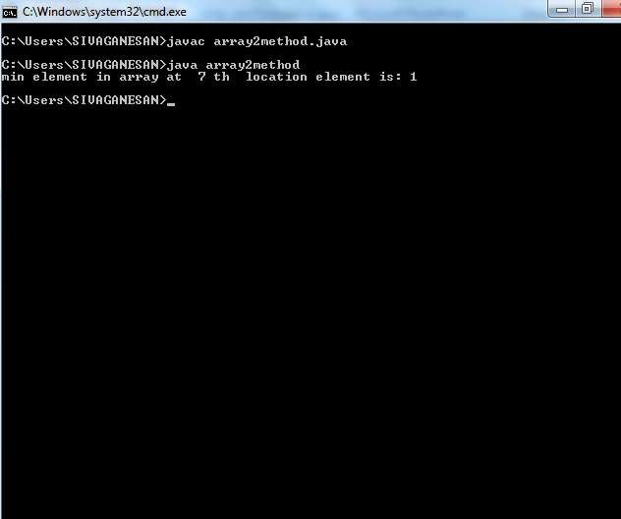
3

Slide 9
Anonymous array.
An array in Java without any name is anonymous array.
It is an array just for creating and using instantly.
We can create an array without name, such type of nameless arrays are called anonymous array.
The main purpose of anonymous array is just for instant use (just for one time usage) .
Anonymous array is passed as an argument of method
Syntax:
// anonymous int array new int[] { 1, 2, 3, 4};
// anonymous char array
new char[] {'x', 'y', 'z');
// anonymous String array
new String[] {"Good", "for", "Go”};
// anonymous multidimensional array
new int[][] { {10, 20}, {30, 40, 50} };
4

Slide 10
class anonarray
{
public static void main(String[] args)
{ // anonymous array
add(new int[]{ 11, 25, 43 });
}
public static void add(int[] a)
{
int sum = 0;
// using for-each loop
for (int i : a) sum = sum + i;
System.out.println("The addition of array elements is:" + sum);
} }
5

Slide 11
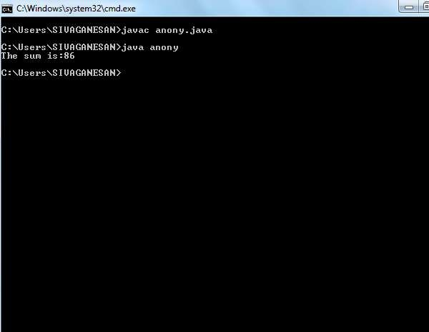
6

Slide 12
Multidimensional Arrays
Multidimensional arrays are arrays of arrays with each element of the array holding
the reference of other array. These are also known as Jagged Arrays.
A multidimensional array is created by appending one set of square brackets ([])
per dimension.
Syntax:
type var-name[ ][ ]=new type[row-size ][col-size ];
Example: //Demonstrate a two-dimensional array.
Class mularray {
public static void main(String args[]) {
int twoD[][]= new int[4][5];
int i, j, k = 0; for(i=0; i<4; i++) for(j=0; j<5; j++)
{ twoD[i][j] = k; k++;
}
for(i=0; i<4; i++)
{ for(j=0; j<5; j++)
System.out.print(twoD[i][j] + " "); System.out.println(); }}}
12

Slide 13
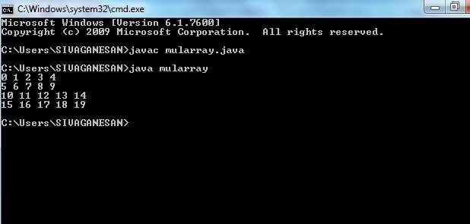
13

Slide 14
When you allocate memory for a multidimensional array, you
need only specify the memory for the first
(leftmost) dimension. You can allocate the remaining dimensions
separately. For example, this following code allocates memory for the first dimension of twoD when it is declared. It allocates the second dimension manually.
Syntax:
int twoD[][] = new int[4][]; twoD[0] = new int[5];
twoD[1] = new int[5]; twoD[2] = new int[5]; twoD[3] = new int[5];

Slide 15
Example:
//Manually allocate differing size second dimensions.
class dymularray
{
public static void main(String args[])
{
int twoD[][] = new int[4][];
twoD[0] = new int[1];twoD[1] = new int[2]; twoD[2] = new int[3]; twoD[3] = new int[4]; int i, j, k = 0;
for(i=0; i<4; i++)
for(j=0; j<i+1; j++)
{ twoD[i][j] = k;k++;}
for(i=0; i<4; i++)
{
for(j=0; j<i+1; j++)
System.out.print(twoD[i][j] + " "); System.out.println();
}}}

Slide 16
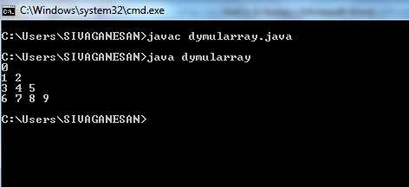
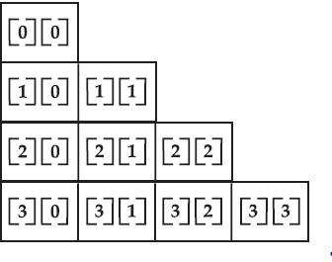
11

Slide 17
Arrays of Objects
An array of objects is created just like an array of primitive type data items in the following way.
Syntax :
classname objname[]=new classname[size]
Ex:
Student[] arr = new Student[5]; //student is a user-defined class
The student Array contains five memory spaces each of size of student class in which the address of five Student objects can be stored.The Student objects have to be instantiated using the constructor of the Student class.

Slide 18
class student
{
int roll; String name;String dept;
student(int rno, String na,String de)
{
this.roll = rno; this.name = na; this.dept=de;
}
void display()
{ System.out.println(roll+"
} }
class arrayobj {
"+name+"
"+dept);
public static void main(String args[])
{ student s[]=new student[3];
int i=0;
s[0]=new student(12,"siva","CSE");
s[1]=new student(23,"ram","ECE");
s[2]=new student(45,"kumar","EEE"); System.out.println("****student details****"); System.out.println( "Rollno Name dept"); for(i=0;i<s.length;i++)
{ s[i].display();}}}

Slide 19
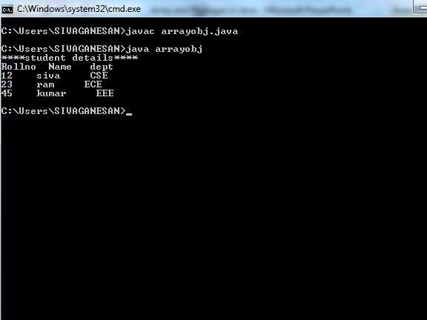
14

Slide 20

20

